Slide 1
AWS Proposed Architecture
^{13th} Dec’24

Slide 2

RM Tool – Integration challenges with DataEdge360
Sr. No. | Analysis- Engine Components | Details
1 | RM Tool- Components | RM Tool is divided into two main components: a user interface for inputting data and scheduling batches, and a Windows service responsible for executing the tasks and crawling data. The Windows service is exclusively configured for VB scripts only.
2 | Windows Service in backend | It is not python code where we can modify as per new platform script, it was developed long back as Windows Service which triggers the VBA Scripts
3 | Complex Design to execute the VBA Scripts | It takes input and converts in XML to pass VBA scripts, further generates the output in XML to be consumed by database
4 | Curser based insertion (1*1) to database | It was designed for low volume requirement and insert 1*1 records in database which takes lot of time for low volume crawling as well
5 | Execute DaaS compliance scripts | Need to develop fresh engine/workflow which will be scalable for any technology platform/scripts to be triggered
6 | Sequential processing | RM Tool, process requests/input sequentially which is coupled with XML-based input and output, results, which slow down the crawling and not fit for high volume like we have in DaaS. Need to design the workflow with multithreading processing of requests
7 | Redesign the schedular and crawling engine | We need to revamp the existing module (UI + Engine ) with latest technology platform
8 | Consolidate the Database and scheduling logs for showing the queue progress on dashboard | We Need to develop the crawling / monitoring dashboard to track the progress of batches
9 | Search / Crawl mechanism | Old RM tool is MPN based, however for DataEdge360- need to have with product URL based input. MPN-based crawling is slower than product URL-based crawling
10 | Technology Dependency and New Proposal | The RM Tool crawling engine is solely built for MPN-based VBA programs, whereas DaaS scripts are based on Python scripts using product URLs. In order for the DaaS scripts to be executed, the existing workflow must be modified and the Python crawling engine should be integrated with the RM tool.
For Internal Circulation Only

Slide 3
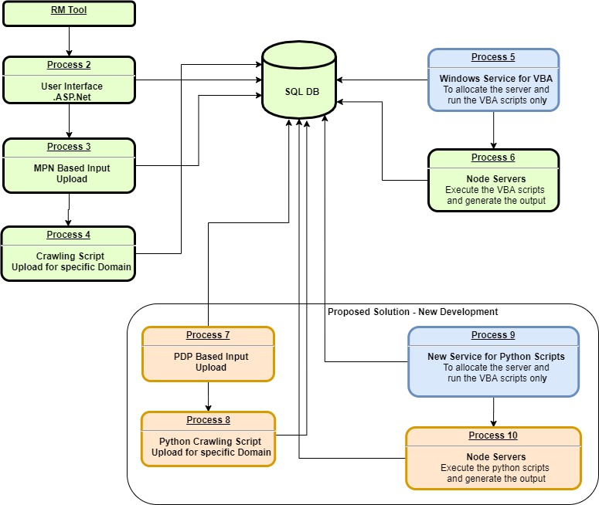
RM Tool – Existing and New Proposed Workflow
For Internal Circulation Only

Slide 4
For Internal Circulation Only

